Slide 1

Designing and Analysis of Algorithm
Han Huang and Xiaowei Yang
South China University of Technology

Slide 2

Chapter 2
Fundamentals of the Analysis of Algorithm Efficiency
Copyright © 2007 Pearson Addison-Wesley. All rights reserved.

Slide 3
2.1 Analysis Framework

Slide 4
2.1 Analysis Framework
Issues:
correctness
time efficiency
space efficiency
optimality
Approaches:
theoretical analysis
empirical analysis

Slide 5
Measuring an Input’s Size
(1) For example, polynomial input
Polynomial’s degree
The number of its coefficients
(2) For example, Matrix input
There are two natural measures of size for this problem.
Matrix order Total number of elements
(3) For example, binary input
The number b of bits in the n’s binary representation

Slide 6
Units of Measuring Running Time
The thing to do is to identify the most important operation of the algorithm, called the basic operation, the operation contributing the most to the total running time, and compute the number of times the basic operation is execute.

Slide 7
Theoretical analysis of time efficiency
Time efficiency is analyzed by determining the number of repetitions of the basic operation as a function of input size
Basic operation: the operation that contributes most towards the running time of the algorithm
T(n) ≈ c_{op}C(n)
input size
running time
execution time
for basic operation
Number of times basic operation is executed

Slide 9
Names for some orders of growth
Θ(1) Constant
Θ(log_{c} n) Logarithmic (same order ∀c)
Θ(log^{c} n) Polylogarithmic
Θ(n) Linear
Θ(n^{c}) Polynomial (for any c)
Θ(c^{n}) Exponential (for c>1)
Θ(n!) Factorial
(With c a constant.)

Slide 10
Tractable vs. intractable
A problem or algorithm with at most polynomial time complexity is considered tractable (or feasible). P is the set of all tractable problems.
A problem or algorithm that has complexity greater than exponential is considered intractable (or infeasible).
Note that n^{1,000,000} is technically tractable, but really very hard. n^{log log log n} is technically intractable, but easy. Such cases are rare though.

Slide 11
Computer Time Examples
(1.25 bytes)
(125 kB)
Assume time = 1 ns (10⁻⁹ second) per op, problem size = n bits, and #ops is a function of n, as shown.

Slide 12
Order of growth
Most important: Order of growth within a constant multiple as n→∞
Example:
How much faster will algorithm run on computer that is twice as fast?
How much longer does it take to solve problem of double input size?
Notes:
Example: cn²
how much faster on twice as fast computer? (2)
how much longer for 2n? (4)

Slide 13
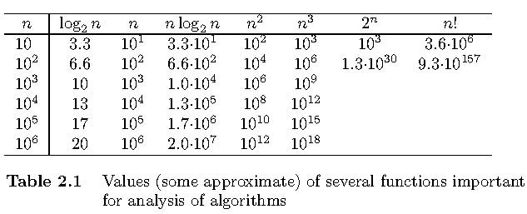
Order of Growths→ ∞

Slide 14
Best-case, average-case, worst-case
For some algorithms efficiency depends on form of input:
Worst case: C_{worst}(n) – maximum over inputs of size n
Best case: C_{best}(n) – minimum over inputs of size n
Average case: C_{avg}(n) – “average” over inputs of size n
Number of times the basic operation will be executed on typical input
NOT the average of worst and best case
Expected number of basic operations considered as a random variable under some assumption about the probability distribution of all possible inputs

Slide 15
Best-case, average-case, worst-case
Algorithmic complexity = cost of computation.
Focus on time complexity for our course.
Although space & energy are also important.
Characterize complexity as a function of input size: worst-case, best-case, or average-case.
Use orders-of-growth notation to concisely summarize the growth properties of complexity functions.

Slide 16
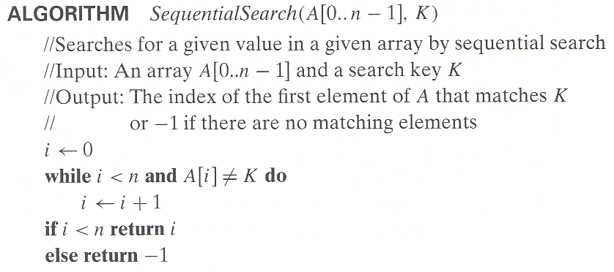
Example: Sequential search
Worst case : n
Best case : 1
Average case:

Slide 17
Recapitulation of the Analysis Framework
Both time and space efficiencies are measured as functions of the algorithm’s input size.
Time efficiency is measured by counting the number of times the algorithm’s basic operation is executed. Space efficiency is measured by counting the number of extra memory units consumed by the algorithm.

Slide 18
Recapitulation of the Analysis Framework
The efficiencies of some algorithms may differ significantly for inputs of the same size. For such algorithms, we need to distinguish between the worst-case, average-case and best-case efficiencies.
The framework’s primary interest lies in the order of growth of the algorithm’s running time (extra memory units consumed) as its input size goes to infinity

Slide 19
2.2 Asymptotic Notations and Basic Efficiency Classes

Slide 20
2.2 Asymptotic Notations and Basic Efficiency Classes
A way of comparing functions that ignores constant factors and small input sizes
O(g(n)): class of functions f(n) that grow no faster than g(n)
Θ(g(n)): class of functions f(n) that grow at same rate as g(n)
Ω(g(n)): class of functions f(n) that grow at least as fast as g(n)

Slide 21
Definition: O(g), at most order g
Let g be any function R→R.
Define “at most order g”, written O(g), to be: {f:R→R | ∃c,k: ∀x>k: f(x) ≤ cg(x)}.
“Beyond some point k, function f is at most a constant c times g (i.e., proportional to g).”
“f is at most order g”, or “f is O(g)”, or “f=O(g)” all just mean that f∈O(g).
Often the phrase “at most” is omitted.

Slide 22
Points about the definition
Note that f is O(g) so long as any values of c and k exist that satisfy the definition.
But: The particular c, k, values that make the statement true are not unique: Any larger value of c and/or k will also work.
You are not required to find the smallest c and k values that work. (Indeed, in some cases, there may be no smallest values!)
However, you should prove that the values you choose do work.

Slide 23
“Big-O” Proof Examples
Show that 30n+8 is O(n).
Show ∃c,k: ∀n>k: 30n+8 ≤ cn.
Let c=31, k=8. Assume n>k=8. Then cn = 31n = 30n + n > 30n+8, so 30n+8 < cn.
Show that n²+1 is O(n²).
Show ∃c,k: ∀n>k: n²+1 ≤ cn².
Let c=2, k=1. Assume n>1. Then cn² = 2n² = n²+n² > n²+1, or n²+1< cn².

Slide 24
Big-O example, graphically
Note 30n+8 isn’t less than n anywhere (n>0).
It isn’t even less than 31n everywhere.
But it is less than 31n everywhere to the right of n=8.
cn = 31n
30n+8
30n+8 ∈O(n)
Value of function →
n
n>k=8 →
Increasing n →

Slide 25
Useful Facts about Big O
Big O, as a relation, is transitive: f∈O(g) ∧ g∈O(h) → f∈O(h)
O with constant multiples, roots, and logs... ∀ f (in ω(1)) & constants a,b∈R, with b≥0, af, f ^{1-b}, and (log_{b} f)ª (a>1) are all O(f).
Sums of functions: If g∈O(f) and h∈O(f), then g+h∈O(f).

Slide 26
More Big-O facts
∀c>0, O(cf)=O(f+c)=O(f−c)=O(f)
f₁∈O(g₁) ∧ f₂∈O(g₂) →
f₁ f₂ ∈O(g₁g₂)
f₁+f₂ ∈O(g₁+g₂) = O(max(g₁,g₂)) = O(g₁) if g₂∈O(g₁)
(Very useful!)

Slide 27
Orders of Growth - So Far
For any g:R→R, “at most order g”, O(g) ≡ {f:R→R | ∃c,k ∀x>k |f(x)| ≤ |cg(x)|}.
Often, one deals only with positive functions and can ignore absolute value symbols.
“f∈O(g)” often written “f is O(g)” or “f=O(g)”.
The latter form is an instance of a more general convention...

Slide 28
Order-of-Growth Expressions
“O(f)” when used as a term in an arithmetic expression means: “some function f such that f∈O(f)”.
E.g.: “x²+O(x)” means “x² plus some function that is O(x)”.
Formally, you can think of any such expression as denoting a set of functions:
x²+O(x) :≡ {g | ∃f∈O(x): g(x)= x²+f(x)}

Slide 29
Order of Growth Equations
Suppose E₁ and E₂ are order-of-growth expressions corresponding to the sets of functions S and T, respectively.
Then the “equation” E₁=E₂ really means ∀f∈S, ∃g∈T : f=g or simply S⊆T.
Example: x² + O(x) = O(x²) means ∀f∈O(x): ∃g∈O(x²): x²+f(x)=g(x)

Slide 30
Useful Facts about Big O
∀ f,g & constants a,b∈R, with b≥0,
af = O(f); (e.g. 3x² = O(x²))
f+O(f) = O(f); (e.g. x²+x = O(x²))
Also, if f=Ω(1) (at least order 1), then:
|f|^{1-b} = O(f); (e.g. x⁻¹ = O(x))
(log_{b} |f|)ª = O(f). (e.g. log x = O(x)) (a>1)
g=O(fg) (e.g. x = O(x log x))
fg ≠ O(g) (e.g. x log x ≠ O(x))
a=O(f) (e.g. 3 = O(x))

Slide 31
Case
Let
are real number.
is

Slide 32
Definition: Θ(g), exactly order g
If f∈O(g) and g∈O(f), then we say “g and f are of the same order” or “f is (exactly) order g” and write f∈Θ(g).
Another, equivalent definition: Θ(g) ≡ {f:R→R | ∃c₁c₂k>0 ∀x>k: |c₁g(x)|≤|f(x)|≤|c₂g(x)| }
“Everywhere beyond some point k, f(x) lies in between two multiples of g(x).”

Slide 33
Rules for Θ
Mostly like rules for O( ), except:
∀ f,g>0 & constants a,b∈R, with b>0, af ∈ Θ(f), but ← Same as with O. f ∉ Θ(fg) unless g=Θ(1) ← Unlike O. |f| ^{1-b} ∉ Θ(f), and ← Unlike with O. (log_{b} |f|)^{c} ∉ Θ(f). ← Unlike with O.
The functions in the latter two cases we say are strictly of lower order than Θ(f).

Slide 34
Θ example
Determine whether:
Quick solution:

Slide 35
Other Order-of-Growth Relations
Ω(g) = {f | g∈O(f)} “The functions that are at least order g.”
o(g) = {f | ∀c>0 ∃k ∀x>k : |f(x)| < |cg(x)|} “The functions that are strictly lower order than g.” o(g) ⊂ O(g) − Θ(g).
ω(g) = {f | ∀c>0 ∃k ∀x>k : |cg(x)| < |f(x)|} “The functions that are strictly higher order than g.” ω(g) ⊂ Ω(g) − Θ(g).

Slide 36
Relations Between the Relations
Subset relations between order-of-growth sets.
R→R
O( f )
Ω( f )
• f
o( f )
Θ( f )
ω( f )

Slide 37
Why o(f)⊂O(x)−Θ(x)
A function that is O(x), but neither o(x) nor Θ(x):

Slide 38
Strict Ordering of Functions
Temporarily let’s write fg to mean f∈o(g), f~g to mean f∈Θ(g)
Note that:
Let k>1. Then the following are true: 1  log log n  log n ~ log_{k} n  log^{k} n  n^{1/k}  n  n log n  n^{k}  k^{n}  n!  n^{n} …

Slide 39
Review: Orders of Growth
Definitions of order-of-growth sets, ∀g:R→R
O(g) :≡ {f | ∃ c>0 ∃k ∀x>k |f(x)| < |cg(x)|}
o(g) :≡ {f | ∀c>0 ∃k ∀x>k |f(x)| < |cg(x)|}
Ω(g) :≡ {f | g∈O(f)}
ω(g) :≡ {f | g∈o(f)}
Θ(g) :≡ O(g) ∩ Ω(g)

Slide 40
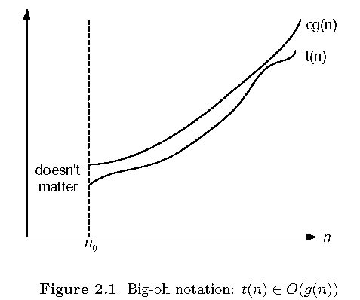
Big-oh

Slide 41
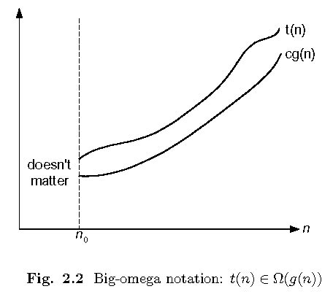
Big-omega

Slide 42
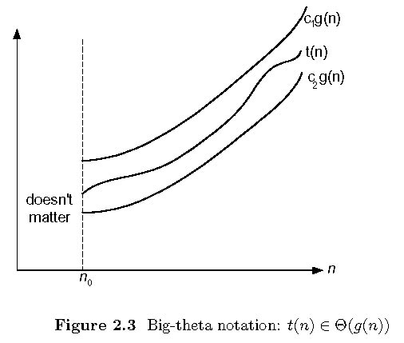
Big-theta

Slide 43
Establishing order of growth using the definition
Definition: f(n) is in O(g(n)) if order of growth of f(n) ≤ order of growth of g(n) (within constant multiple), i.e., there exist positive constant c and non-negative integer n₀ such that
f(n) ≤ c g(n) for every n ≥ n₀
Examples:
10n is O(n²) 5n+20 is O(n)
Notes:
Examples:
10n is O(n²)
since 10n ≤ 10n² for n ≥ 1 or 10n ≤ n² for n ≥ 10
c n₀
5n+20 is O(10n)
since 5n+20 ≤ 10 n for n ≥ 4
c n₀

Slide 44
Some properties of asymptotic order of growth
f(n) ∈ O(f(n))
f(n) ∈ O(g(n)) iff g(n) ∈Ω(f(n))
If f (n) ∈ O(g (n)) and g(n) ∈ O(h(n)) , then f(n) ∈ O(h(n)) Note similarity with a ≤ b
If f₁(n) ∈ O(g₁(n)) and f₂(n) ∈ O(g₂(n)) , then
f₁(n) + f₂(n) ∈ O(max{g₁(n), g₂(n)})

Slide 45
Establishing order of growth using limits
lim T(n)/g(n)
=
n→∞
0 order of growth of T(n) < order of growth of g(n)
c > 0 order of growth of T(n) = order of growth of g(n)
∞ order of growth of T(n) > order of growth of g(n)
Examples:
10n vs. n²
n(n+1)/2 vs. n²

Slide 46
L’Hôpital’s rule and Stirling’s formula
L’Hôpital’s rule:
If lim_{n→∞} f(n) = lim_{n→∞} g(n) = ∞ and
the derivatives f´, g´ exist, then
Stirling’s formula: n! ≈ (2πn)^{1/2} (n/e)^{n}
f(n)
g(n)
f ´(n)
g ´(n)
lim
n→∞
=
lim
n→∞
Example: log n vs. n
Example: 2^{n} vs. n!

Slide 47
Orders of growth of some important functions
All logarithmic functions log_{a} n belong to the same class Θ(log n) no matter what the logarithm’s base a > 1 is
All polynomials of the same degree k belong to the same class:
a_{k}n^{k} + a_{k-1}n^{k-1} + … + a₀ ∈ Θ(n^{k})
Exponential functions a^{n} have different orders of growth for different a’s
order log n < order n^{α} (α>0) < order a^{n} < order n! < order n^{n}

Slide 48
Basic asymptotic efficiency classes
1 | constant
log n | logarithmic
n | linear
n log n | n-log-n
n² | quadratic
n³ | cubic
2^{n} | exponential
n! | factorial

Slide 49
2.3 Mathematical Analysis of Nonrecursive Algorithms

Slide 50
Time efficiency of nonrecursive algorithms
General Plan for Analysis
Decide on parameter n indicating input size
Identify algorithm’s basic operation
Determine worst, average, and best cases for input of size n
Set up a sum for the number of times the basic operation is executed
Simplify the sum using standard formulas and rules

Slide 51
Example 1: Max algorithm
Problem: Find the simplest form of the exact order of growth (Θ) of the worst-case time complexity (w.c.t.c.) of the max algorithm, assuming that each line of code takes some constant time every time it is executed (with possibly different times for different lines of code).

Slide 52
Input size and basic operation examples
Problem | Input size measure | Basic operation
Searching for key in a list of n items | Number of list’s items, i.e. n | Key comparison
Multiplication of two matrices | Matrix dimensions or total number of elements | Multiplication of two numbers
Checking primality of a given integer n | n’size = number of digits (in binary representation) | Division
Typical graph problem | #vertices and/or edges | Visiting a vertex or traversing an edge

Slide 53
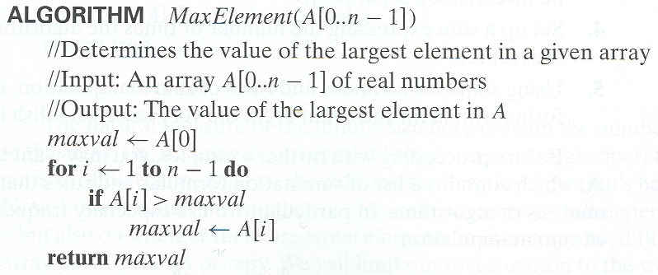
Example 1: Maximum element

Slide 54
Complexity analysis of max
procedure max(a₁, a₂, …, a_{n}: integers)
v := a₁ t₁
for i := 2 to n t₂
if a_{i} > v then v := a_{i} t₃
return v t₄
First, what’s an expression for the exact total worst-case time? (Not its order of growth.)
Times for each execution of each line.

Slide 55
Complexity analysis, cont.
procedure max(a₁, a₂, …, a_{n}: integers)
v := a₁ t₁
for i := 2 to n t₂
if a_{i} > v then v := a_{i} t₃
return v t₄
w.c.t.c.:
Times for each execution of each line.

Slide 56
Complexity analysis, cont.
Now, what is the simplest form of the exact (Θ) order of growth of t(n)?

Slide 57
General Plan
Decide on a parameter (or parameters) indicating an input’s size.
Identify the algorithm’s basic operation. (As a rule, it is located in its innermost loop)
Check whether the number of times the basic operation is executed depends only on the size of an input. If it also depends on some additional property, the worst-case, average-case, and, if necessary, best-case efficiencies have to be investigated separately.

Slide 58
General Plan
4. Set up a sum expressing the number of times the algorithm’s basic operation is executed.
5. Using standard formulas and rules of sum manipulation, either find a closed-form formula for the count or, at the very least, establish its order of grown.

Slide 59
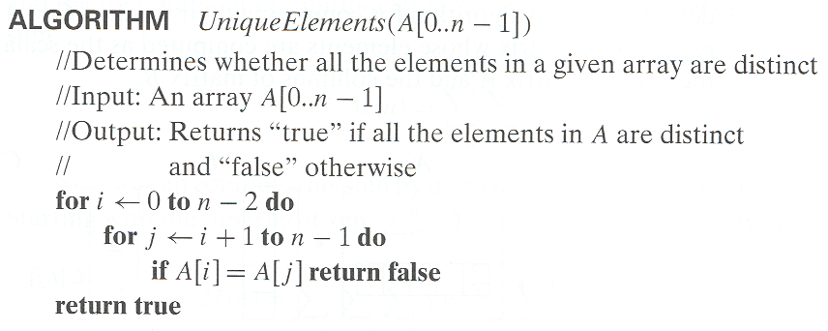
Example 2: Element uniqueness problem

Slide 61
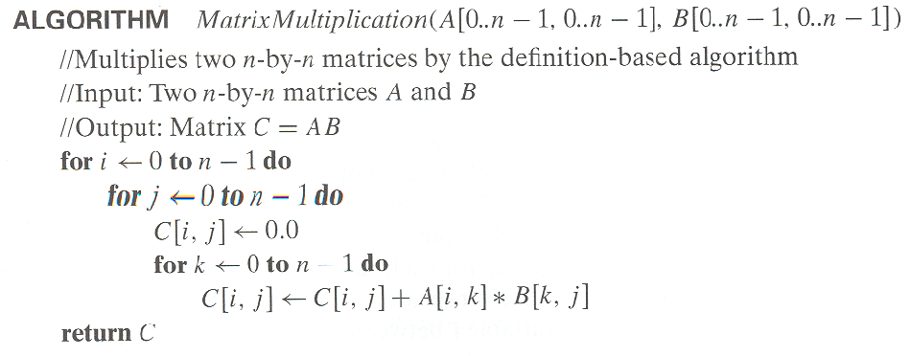
Example 3: Matrix multiplication
Step1：初始化矩阵
Step2：更新矩阵

Slide 62
Example 4: Gaussian elimination
Algorithm GaussianElimination(A[0..n-1,0..n])
//Implements Gaussian elimination of an n-by-(n+1) matrix A
for i ← 0 to n - 2 do for j ← i + 1 to n - 1 do for k ← i to n do
A[j,k] ← A[j,k] - A[i,k] ∗ A[j,i] / A[i,i]
Find the efficiency class and a constant factor improvement.

Slide 63
Total number of multiplication

Slide 64
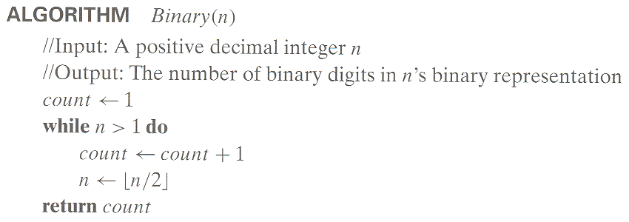
Example 4: Counting binary digits

Slide 65
Example 5: Linear Search
procedure linear search (x: integer, a₁, a₂, …, a_{n}: distinct integers) i := 1 t₁ while (i ≤ n ∧ x ≠ a_{i}) t₂ i := i + 1 t₃ if i ≤ n then location := i t₄ else location := 0 t₅ return location t₆

Slide 66
Linear search analysis
Worst case time complexity order:
Best case:
Average case, if item is present:

Slide 67
Example 6: Binary Search
procedure binary search (x:integer, a₁, a₂, …, a_{n}: distinct integers, sorted smallest to largest) i := 1 j := n while i<j begin m := ⎣(i+j)/2⎦ if x>a_{m} then i := m+1 else j := m end if x = a_{i} then location := i else location := 0 return location
Key question: How many loop iterations?
Θ(1)
Θ(1)
Θ(1)

Slide 68
Binary search analysis
Suppose that n is a power of 2, i.e., ∃k: n=2^{k}.
Original range from i=1 to j=n contains n items.
Each iteration: Size j−i+1 of range is cut in ~half.
Loop terminates when size of range is 1=2⁰ (i=j).
Therefore, the number of iterations is: k = log₂n = Θ(log₂ n)= Θ(log n)
Even for n≠2^{k} (not an integral power of 2), time complexity is still Θ(log₂ n) = Θ(log n).

Slide 69
Types of formulas for basic operation’s count
Exact formula
e.g., C(n) = n(n-1)/2
Formula indicating order of growth with specific multiplicative constant
e.g., C(n) ≈ 0.5 n²
Formula indicating order of growth with unknown multiplicative constant
e.g., C(n) ≈ cn²

Slide 70
Useful summation formulas and rules
Σ_{l≤i≤u}1 = 1+1+…+1 = u - l + 1

Slide 71
Useful summation formulas and rules
In particular, Σ_{1≤i≤n}1 = n - 1 + 1 = n ∈ Θ(n)
Σ_{1≤i≤n} i = 1+2+…+n = n(n+1)/2 ≈ n²/2 ∈ Θ(n²)
Σ_{1≤i≤n} i² = 1²+2²+…+n² = n(n+1)(2n+1)/6 ≈ n³/3 ∈ Θ(n³)
Σ_{0≤i≤n} a^{i} = 1 + a +…+ a^{n} = (a^{n+1} - 1)/(a - 1) for any a ≠ 1

Slide 72
Useful summation formulas and rules
In particular, Σ_{0≤i≤n} 2^{i} = 2⁰ + 2¹ +…+ 2^{n} = 2^{n+1} - 1 ∈ Θ(2^{n} ) Σ(a_{i} ± b_{i} ) = Σa_{i} ± Σb_{i} Σca_{i} = cΣa_{i} Σ_{l≤i≤u}a_{i} = Σ_{l≤i≤m}a_{i} + Σ_{m+1≤i≤u}a_{i}

Slide 73
2.4 Mathematical Analysis of Recursive Algorithms

Slide 74
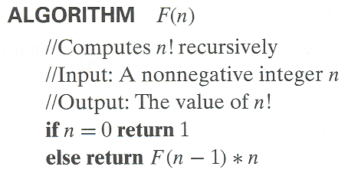
Example 1: Recursive evaluation of n!
Definition: n ! = 1 ∗ 2 ∗ … ∗(n-1) ∗ n for n ≥ 1 and 0! = 1
Recursive definition of n!: F(n) = F(n-1) ∗ n for n ≥ 1 and F(0) = 1
Size:
Basic operation:
Recurrence relation:
Notes:
Note the difference between the two recurrences. Students often confuse these!
F(n) = F(n-1) n
F(0) = 1
for the values of n!
------------
M(n) =M(n-1) + 1
M(0) = 0
for the number of multiplications made by this algorithm

Slide 75
Solving the recurrence for M(n)
M(n) = M(n - 1) + 1, M(0) = 0
M(n) = M(n - 1) + 1
= [M(n - 2) + 1] + 1= M(n - 2) + 2
= [M(n - 3) + 1] + 2= M(n - 3) + 3
M(n) = M(n - 1) + 1 = … = M(n - i) + i
= M(n - n) + n
= n

Slide 76
Plan for Analysis of Recursive Algorithms
Decide on a parameter indicating an input’s size.
Identify the algorithm’s basic operation.
Check whether the number of times the basic op. is executed may vary on different inputs of the same size. (If it may, the worst, average, and best cases must be investigated separately.)
Set up a recurrence relation with an appropriate initial condition expressing the number of times the basic op. is executed.
Solve the recurrence (or, at the very least, establish its solution’s order of growth) by backward substitutions or another method.

Slide 77
Example 2: The Tower of Hanoi Puzzle
Recurrence for number of moves:
1
3
2

Slide 78
Solving recurrence for number of moves
M(n) = M(n-1) + 1 + M(n-1) for n > 1
M(n) = 2M(n-1) + 1 for n > 1, M(1) = 1
M(n) = 2M(n-1) + 1
= 2[2M(n-2) + 1]+1=2*2*M(n-2)+2+1
= 2*2 [2M(n-3) + 1]+2+1
= 2*2*2*M(n-3)+2*2+2+1
=……
=2^(n-1)*M(n-(n-1))+2^(n-1)-1
=2^(n-1)*M(1)+2^(n-1)-1
=2^(n-1)+2^(n-1)-1=2^n-1

Slide 79
Tree of calls for the Tower of Hanoi Puzzle

Slide 80
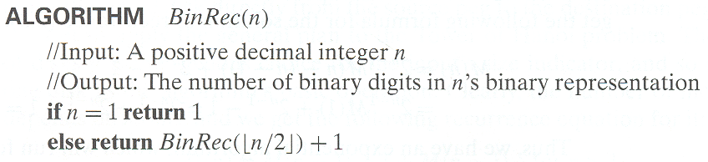
Example 3: Counting #bits

Slide 82
2.5 Fibonacci numbers

Slide 83
Fibonacci numbers
The Fibonacci numbers:
0, 1, 1, 2, 3, 5, 8, 13, 21, …
The Fibonacci recurrence:
F(n) = F(n-1) + F(n-2)
F(0) = 0
F(1) = 1
General 2nd order linear homogeneous recurrence with
constant coefficients:
aX(n) + bX(n-1) + cX(n-2) = 0

Slide 84
Solving aX(n) + bX(n-1) + cX(n-2) = 0
Set up the characteristic equation (quadratic)
ar² + br + c = 0
Solve to obtain roots r₁ and r₂
General solution to the recurrence
if r₁ and r₂ are two distinct real roots: X(n) = αr₁^{n} + βr₂^{n}
if r₁ = r₂ = r are two equal real roots: X(n) = αr^{n} + βnr ^{n}
Particular solution can be found by using initial conditions

Slide 85
Application to the Fibonacci numbers
F(n) = F(n-1) + F(n-2)
or
F(n) - F(n-1) - F(n-2) = 0
Characteristic equation:
Roots of the characteristic equation:
General solution to the recurrence:
Particular solution for F(0) =0, F(1)=1:

Slide 89
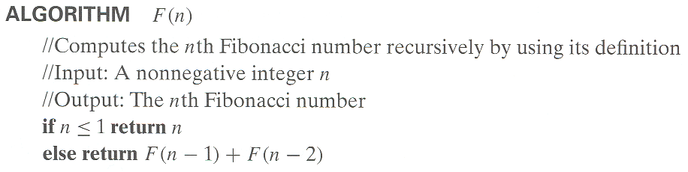
Algorithm for Computing Fibonacci Number

Slide 92
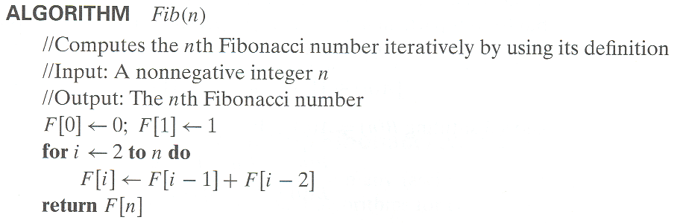

Slide 93
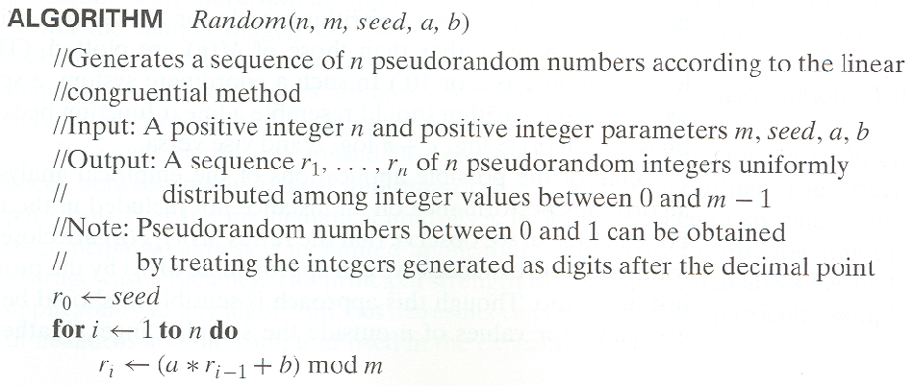

Slide 94
2.6 Empirical Analysis
of Algorithm

Slide 95
2.6 Empirical Analysis of Algorithm
Some seeming simple algorithms have been proved be very difficult to analyze with mathematical precision and certainty.
This is especially true for average-case analysis.
The principal alternative to the mathematical analysis of an algorithm’s efficiency is its empirical analysis. This approach implies the steps spelled out in the following plan.

Slide 96
General Plan for Empirical Analysis of Algorithm Time Efficiency
Understand the experiment’s purpose.
Decide on the efficiency metric M to be measured and the measurement unit (an operation’s count vs. a time unit).
Decide on characteristics of the input sample (its range, size, and so on)
Prepare a program implementing the algorithm(s) for the experimentation.
Generate a sample of inputs.
Run the algorithm(s) on the sample’s inputs and record the data observed.
Analyze the data obtained.

Slide 97
The first alternative is to insert a counter into a program implementing the algorithm to count the number of times the algorithm’s basic operation is executed.
The second alternative is to time the program implementing the algorithm in question.
Clock (C++) currentTimeMills() (JAVA)

Slide 98
However,……
1. a system’s time is typically not very accurate.
2. given the high speed of modern computers, the running time may fail to register at all and be reported as zero.
3. on a computer running under a time-sharing system, the reported time may include the time spent by the CPU on other programs.

Slide 99
Measuring time spent on different segments of a program can point a bottleneck in the program’s performance that can be missed by an abstract deliberation about the algorithm’s basic operation.
Getting such data – called profiling – is an important resource in the empirical analysis of an algorithm’s running time; the data in question can usually be obtained from the system tools available in most computing environments.

Slide 100
Whether you decide to measure the efficiency by basic operation counting or by time clocking, you will need to decide on a sample of inputs for the experiment.
The principal advantage of size changing according to a pattern is that its impact is easier to analyze.
Another important issue concerning sizes in an experiment’s sample is whether several instances of the same size should be included.
Even if we decide to use a pattern for input sizes, we typically want instances themselves generated randomly.

Slide 101
Linear congruential method

Slide 102
The simplicity of the algorithm’s pseudocode is misleading because the devil lies in the details of choosing the algorithm’s parameters.
One of the possible applications of the empirical analysis is to predict the algorithm’s performance on an instance not included in the experiment sample.

Slide 103
The principal strength of empirical analysis lies in its applicability to any algorithm, but its results can depend on the particular sample of instances and the computer used in the experiment.

Slide 104
Summary

Slide 105
Summary 1
There are two kinds of algorithm efficiency:
time efficiency and space efficiency.
Time efficiency indicates how fast the algorithm runs;
Space efficiency deals with the extra space it requires.

Slide 106
Summary 2
An algorithm’s time efficiency is principally measured as a function of its input size by counting the number of time its basic operation is executed .
A basic operation is the operation that contributes must toward running time.
Typically, it is the most time-consuming operation in the algorithm’s innermost loop.

Slide 107
Summary 3
For some algorithms, the running time may differ considerably for inputs of the same size, leading to worst-case efficiency, average-case efficiency, and best-case efficiency.
The established framework for analyzing an algorithm’s time efficiency is primarily grounded in the order of growth of the algorithm’s running time as its input size goes to infinity.

Slide 108
Exercise OF CHAP 2
Bubble sort steps are as follows.
for i←1 to n-1 do
for j ← 1 to n-i do
if a[j]<a[j+1] then
Exchange a[j],a[j+1];
Analysis of time complexity.

Slide 109
Exercise OF CHAP 2
Number of inner iteration: n-i
the time it costs:
Number of outer iteration: n-1
the time it costs:
time complexity：O(n²)

Slide 110
Exercise OF CHAP 2
时间复杂度分析
1）int fact(int n){
if (n<=l) return 1;
return n*fact(n-1);}
2）for(i=n-l;i>l;i--)
for(j=1;j<i;j++)
if (A[j]>A[j+l]){
temp = A[j];// A[j]与 A[j+1]对换;
A[j] = A[j+1];
A[j+1] = temp;}

Slide 111
End of the Section 2
Click to edit company slogan .

